Slide 1

ANZ CUSTOMER ANALYSIS
By Xia Gu

Slide 2
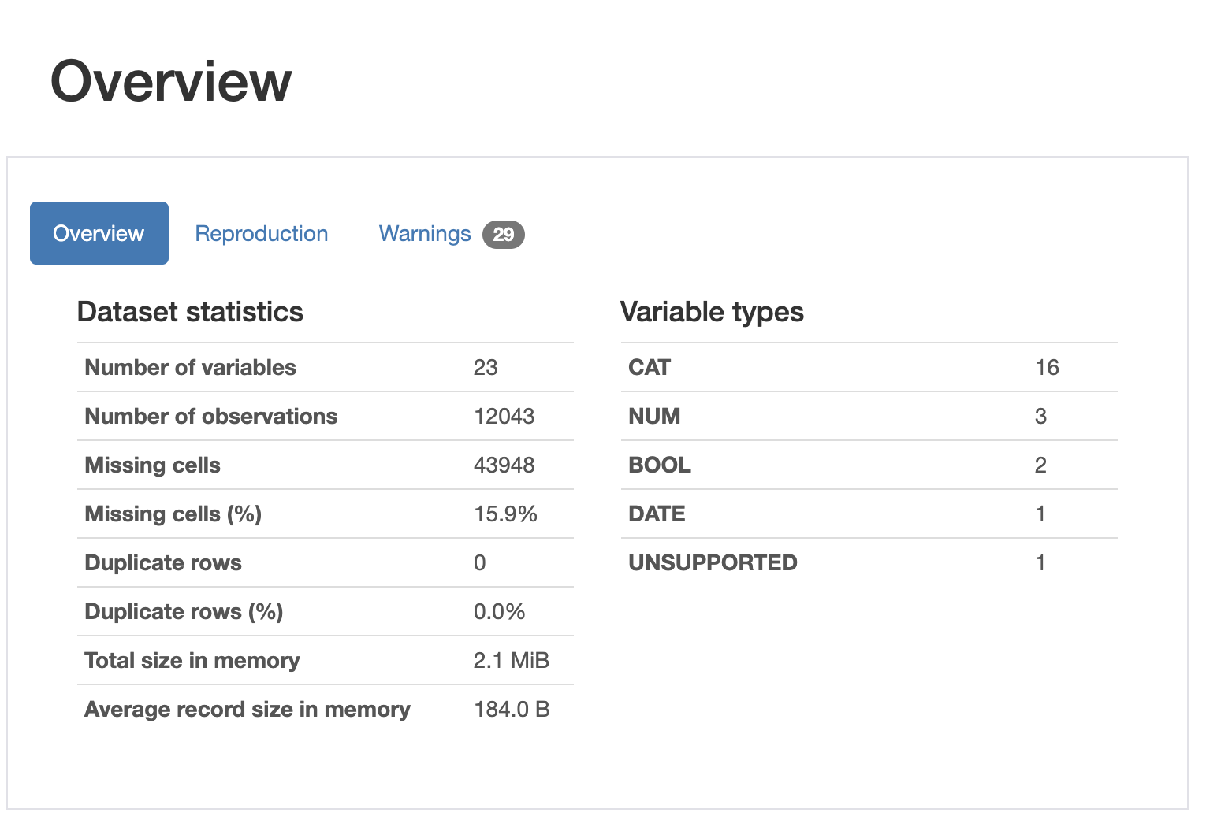
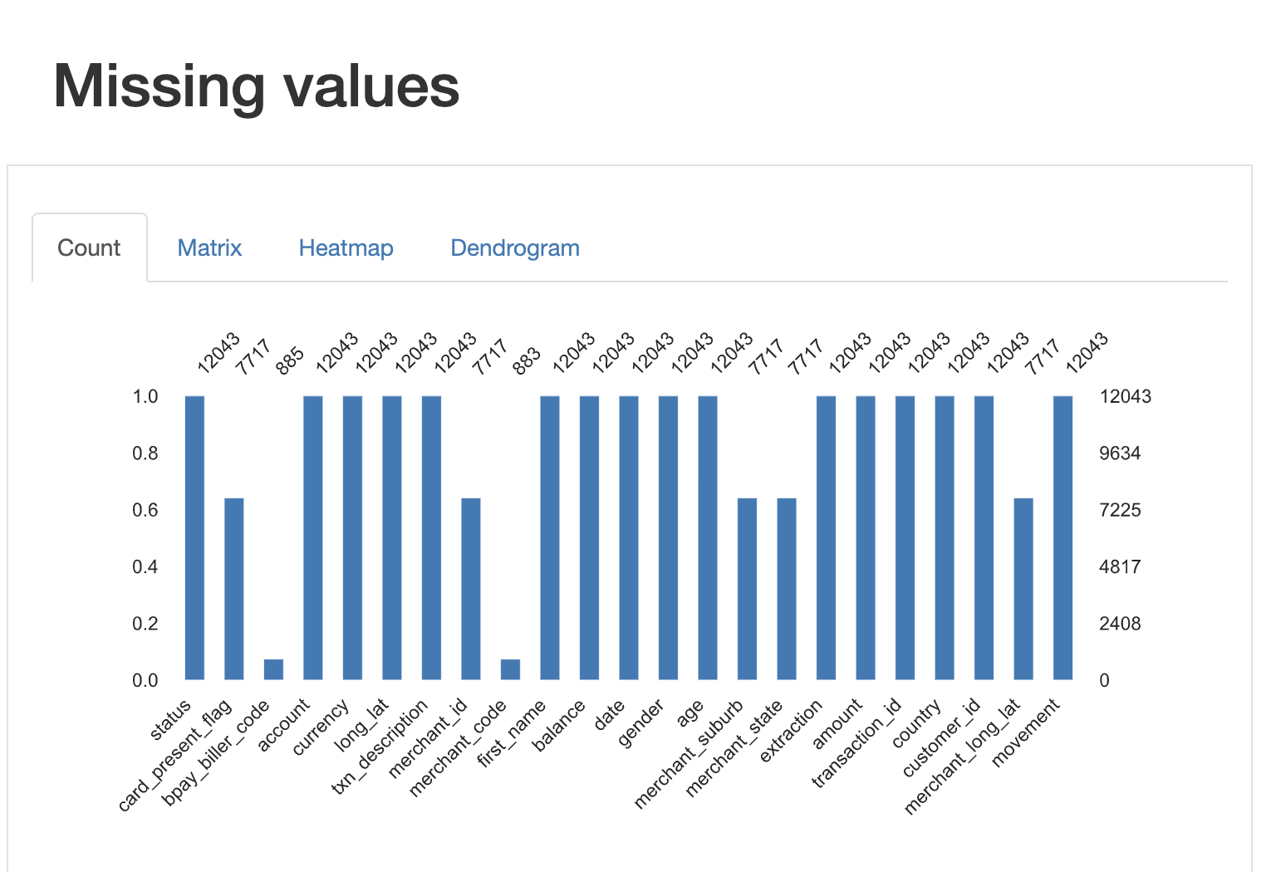
OVERVIEW – Data Quality
Main data quality issues – Missing values
43,948 in 7 columns (15.9%)
Data cleaning: Vary from stakeholders' needs.
e.g. <merchant_state> is critical when analysing customer's behaviors by locations, so data cleaning is required here. However, if analysing customers' behaviors by gender, no need for cleaning in this case.

Slide 3
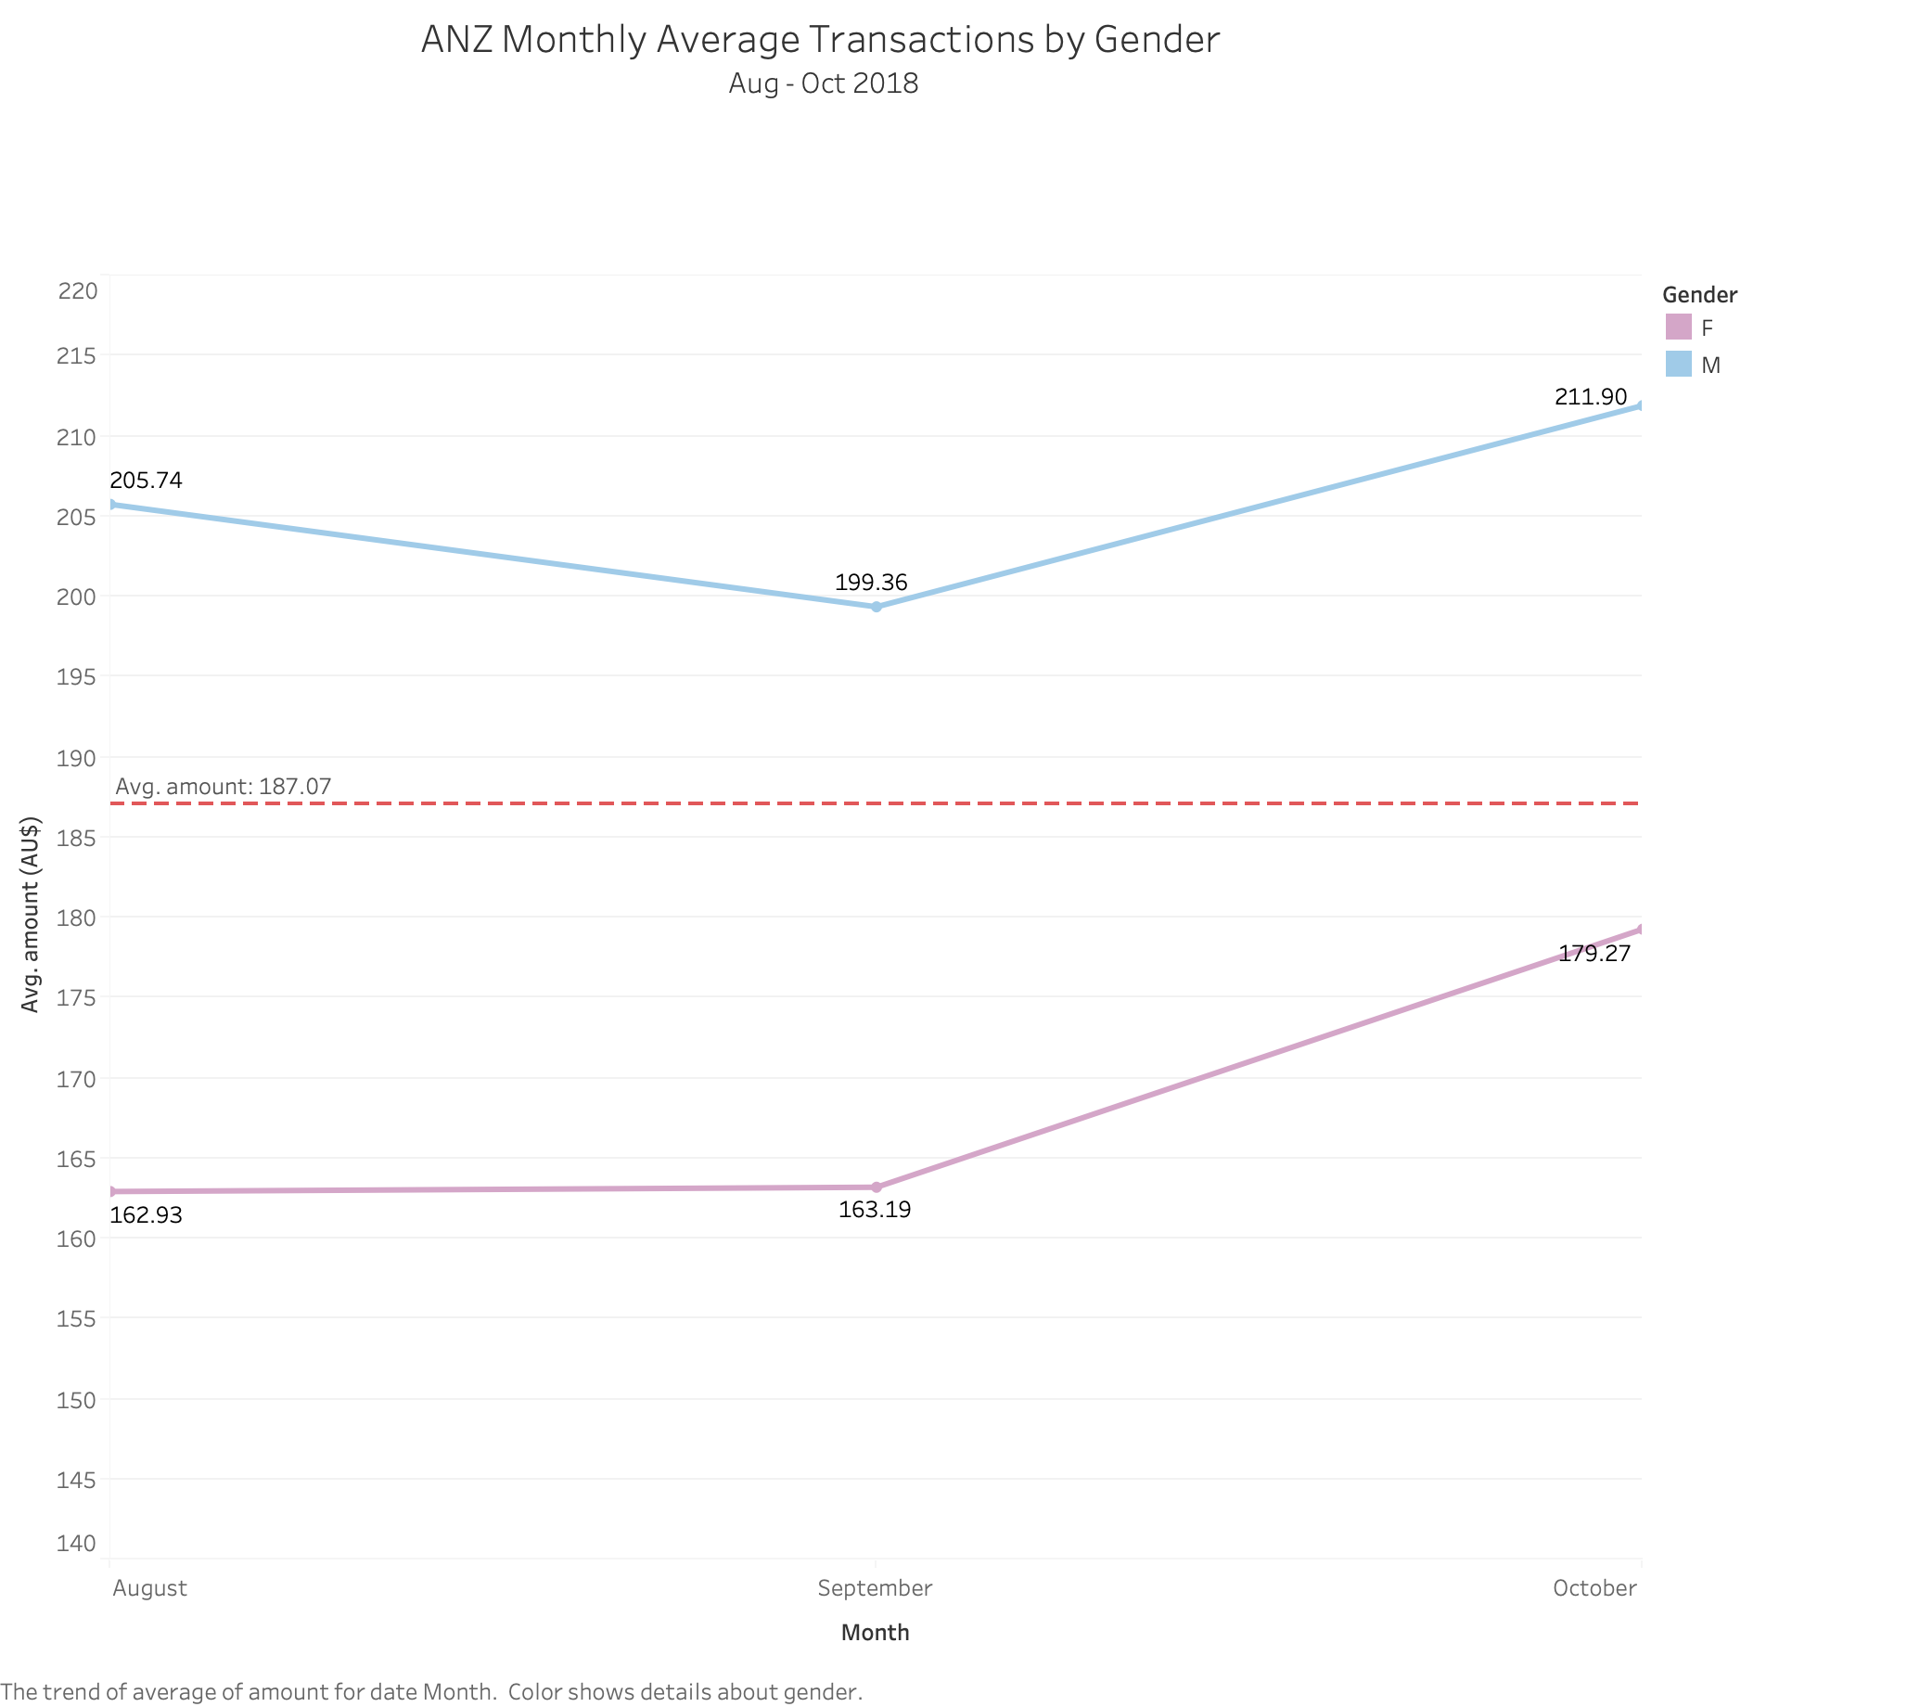
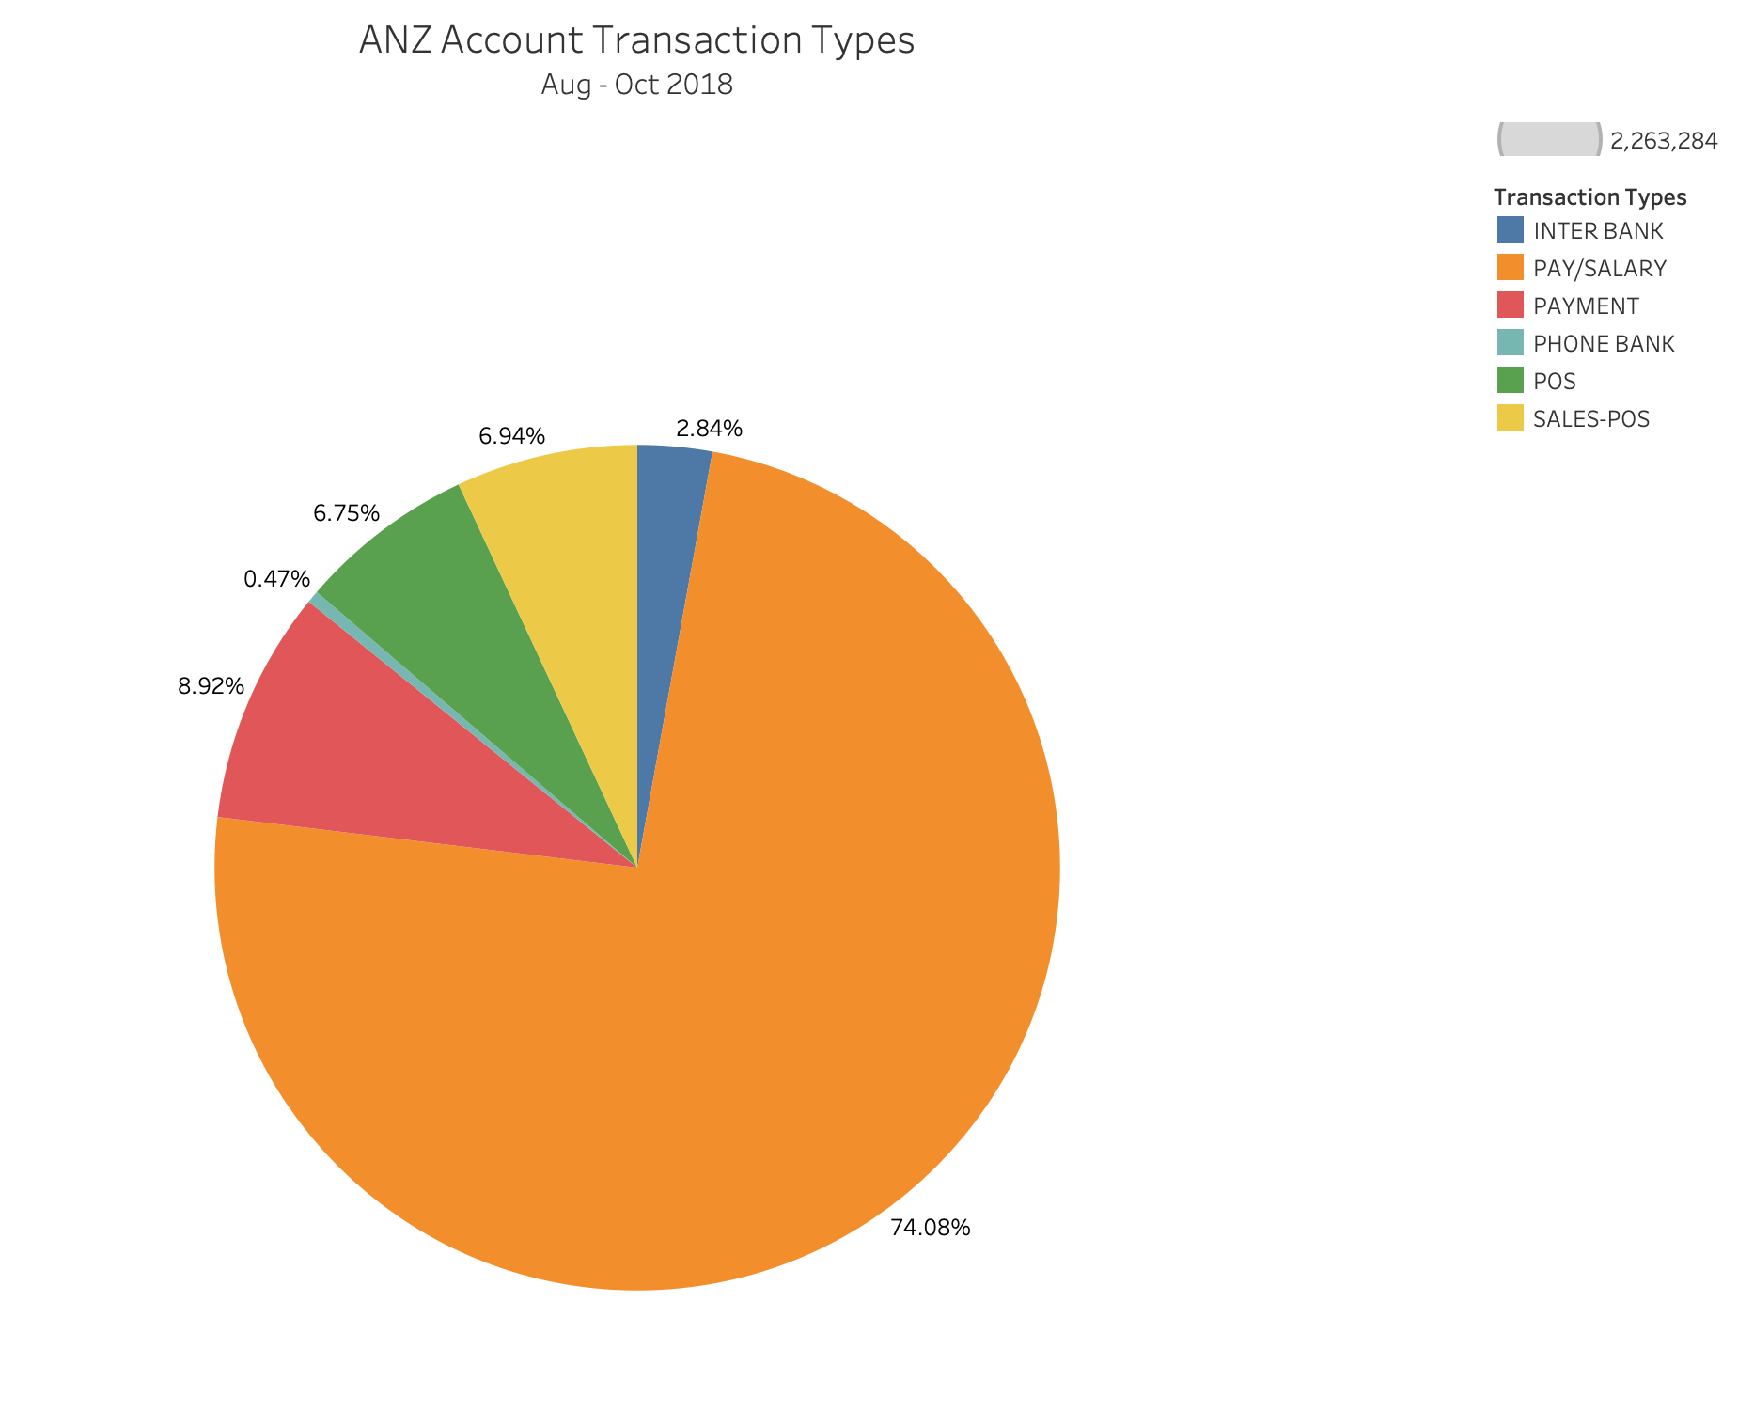
OVERVIEW ANALYSIS
The average amount of transactions is AU$187.07 during Aug – Oct 2018.
Male's transactions are always above the average line and much more than female's in these three months.
The majority amount of transactions occurred in "PAY/SALARY" which indicates the resource of payment is mainly from the salary.
"PHONE BANK" occupies the least (0.47%), this may support decisions on decrease cost in Phone Bank service.

Slide 4
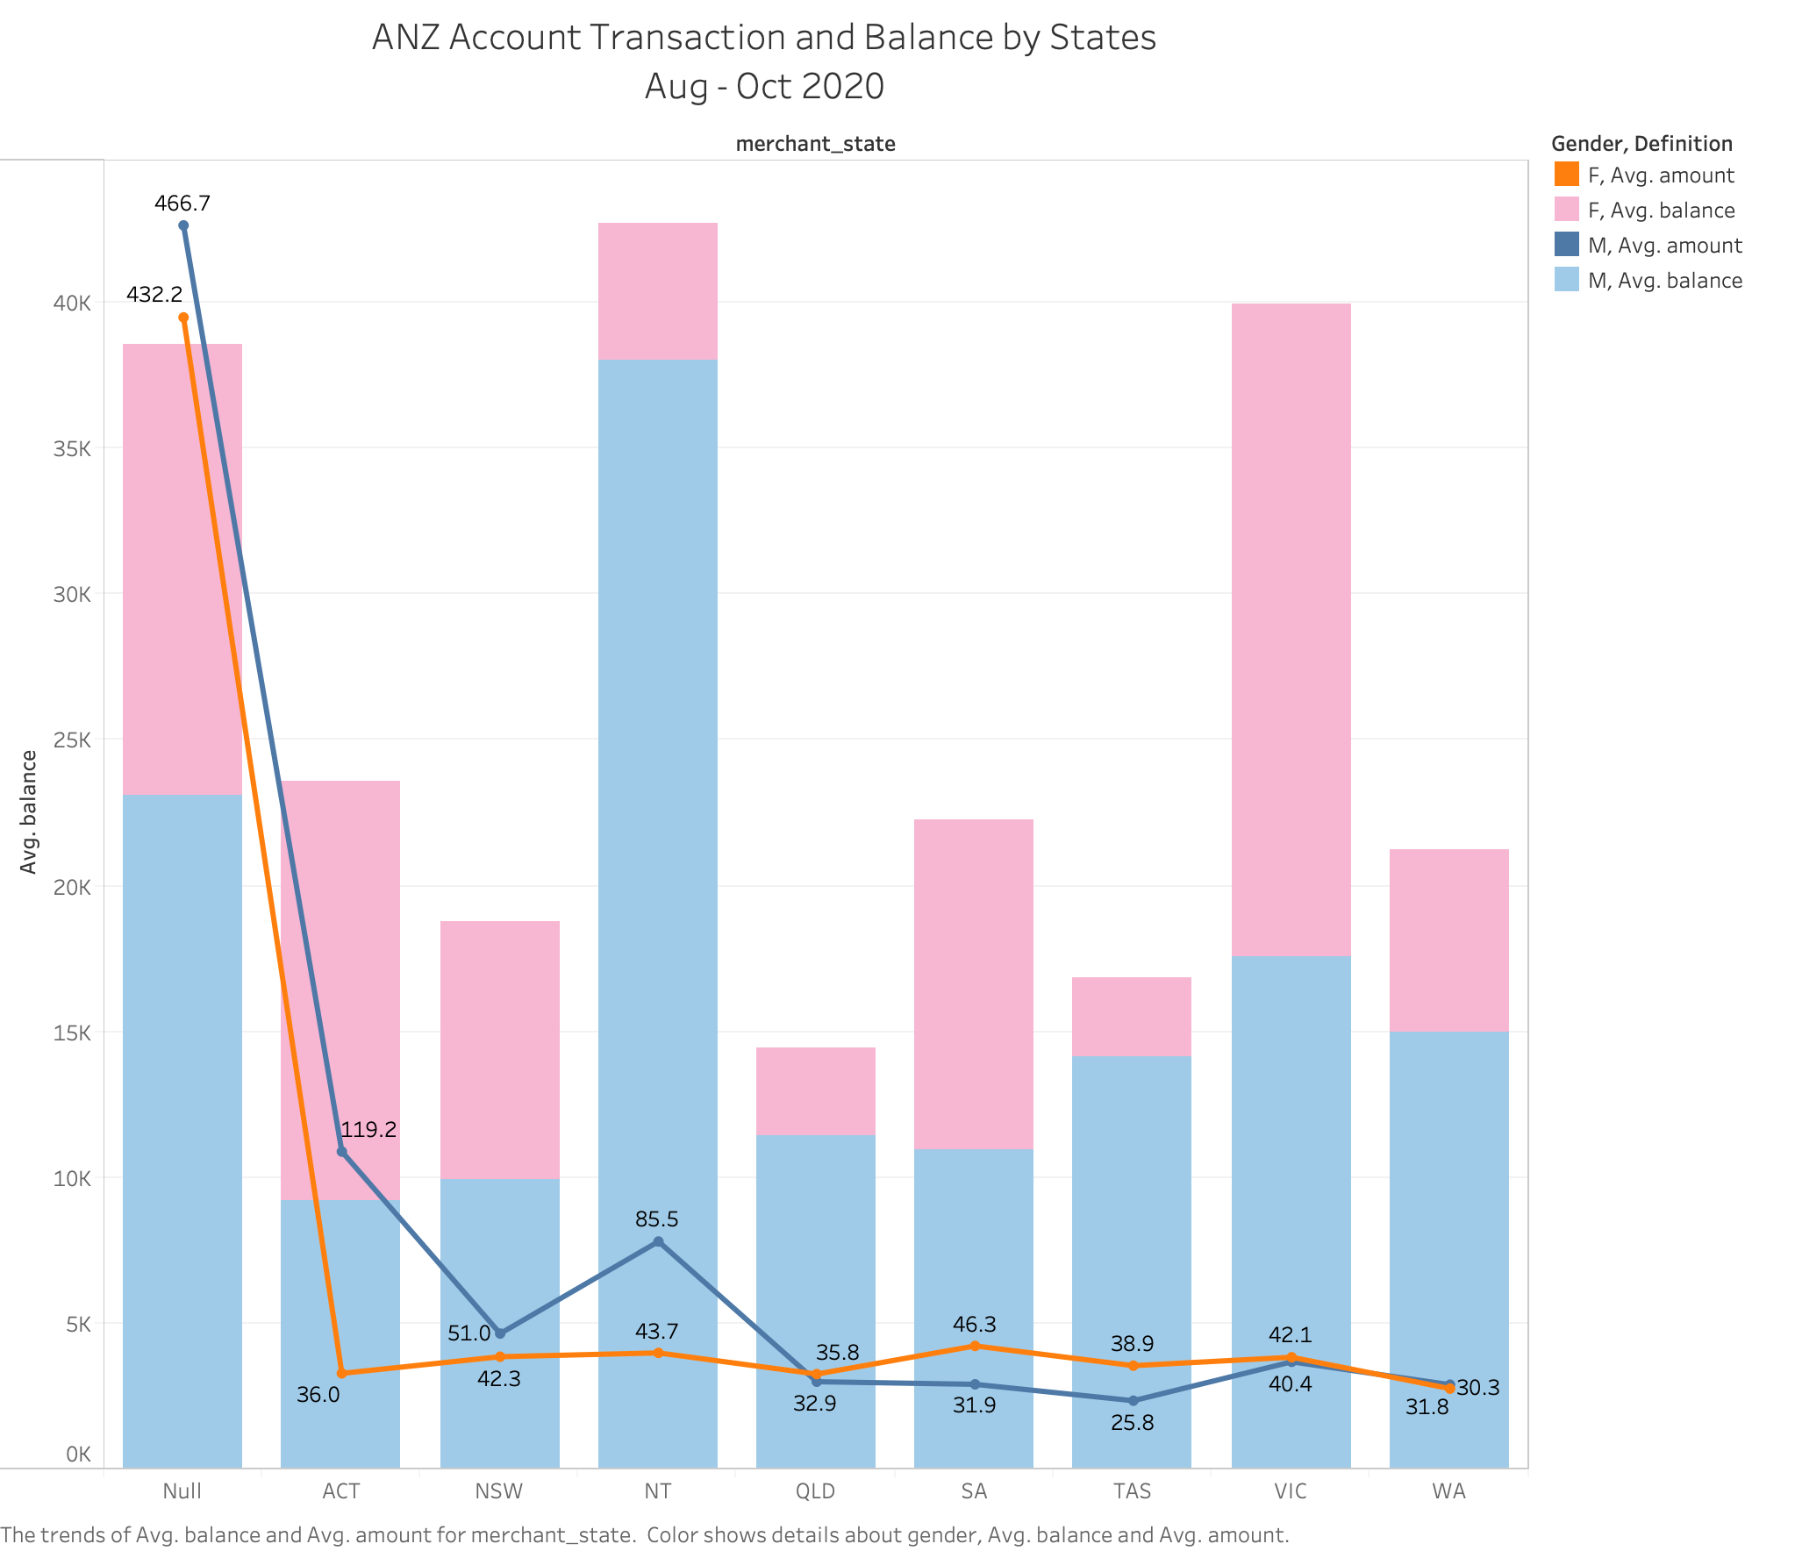
ANALYSIS by STATES
Missing values on the states information significantly affect the analysis result (Null).
Generally, accounts from North Territory have the largest amount of balance specially for males' account which are far ahead from other states. While for the second one in Victoria, account balance is distributed almost 50-50 between female and male. Reasons needs to be further investigated.
For transaction amount, males amount is larger than female in ACT, NSW and NT, but in SA and TAS, female's transaction amount is larger.
Notes:
Actions for missing location value:
- Retrieve state info from suburb info
- Delete the entire data if there is missing values on locations
- Reflect the missing values in insight report
- In the future, update the SOP of new account application, state info can be compulsory info when fill in the application form.

